Slide 1



KONGU ENGINEERING COLLEGE DEPARTMENT OF ELECTRONICS AND COMMUNICATION ENGINEERING COMPARITIVE ANALYSIS ON EARLY GASTRIC CANCER PREDICTION USING ENDOSCOPIC IMAGES
GUIDED BY
Ms. INDHUMATHI N,
Assistant Professor, Department of ECE, Kongu Engineering College.
PROJECT BY
22ECR166 – SARANKUMAR S S
1

Slide 2
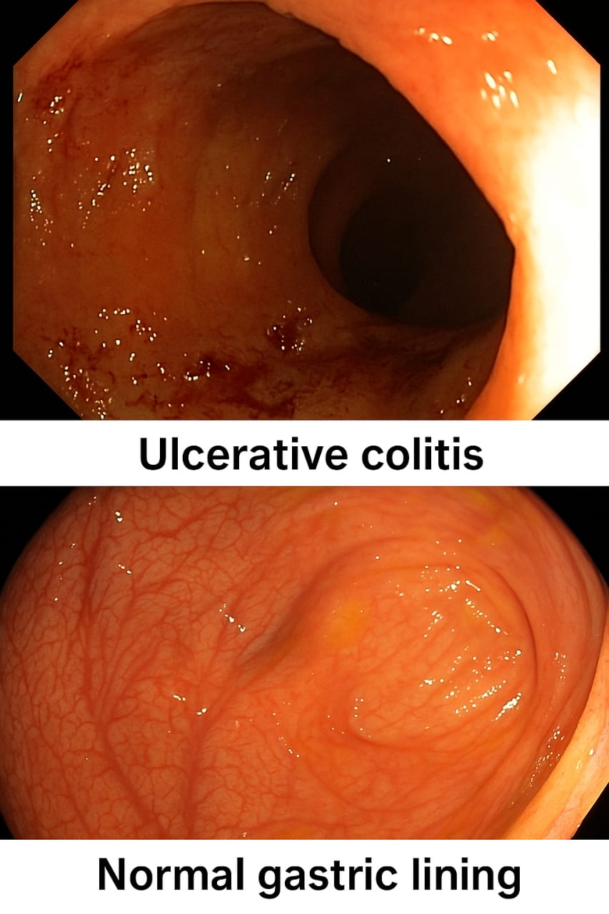
INTRODUCTION
Gastric cancer remains one of the leading causes of cancer-related deaths globally.
Early-stage detection using endoscopic imaging is critical but prone to human error. Leveraging deep learning, especially Convolutional Neural Networks (CNNs), enables automated and accurate identification of gastric abnormalities.
This project utilizes the Kvasir dataset for classifying various gastrointestinal conditions, contributing towards early gastric cancer detection.

Slide 3
PROBLEM STATEMENT
Early detection of gastric cancer significantly improves patient outcomes, yet remains challenging due to subtle visual cues in endoscopic images.
Moreover, reliance on manual interpretation introduces variability and the risk of missed diagnosis, emphasizing the need for robust automated methods using deep learning.
3

Slide 4
LITERATURE SURVEY
EARLY GASTRIC CANCER PREDICTION USING ENDOSCOPIC IMAGES
PAPER TITLE | AUTHOR(S) | YEAR | TECHNOLOGY USED | PROS | CONS
Computer-aided diagnosis of gastric cancer using endoscopic images | T. Takizawa et al. | 2012 | Handcrafted features + SVM | Simple & interpretable | Very low accuracy, can't detect complex patterns
Gastric cancer detection using texture and color features | M. Aoyama et al. | 2014 | Color-texture feature extraction | Lightweight model | Poor performance in real-time, lacks automation
Detection of early gastric cancer using CNN | Y. Hirasawa et al. | 2017 | CNN | Detects lesions from large dataset | Struggles with false positives, lacks interpretability

Slide 5
LITERATURE SURVEY
EARLY GASTRIC CANCER PREDICTION USING ENDOSCOPIC IMAGES
PAPER TITLE | AUTHOR(S) | YEAR | TECHNOLOGY USED | PROS | CONS
Deep learning for gastrointestinal disease detection | S. Urban et al. | 2018 | CNN, DeepLab | Broad coverage of GI tract | Limited gastric-specific accuracy, complex setup
Automated gastric ulcer classification | Iakovidis et al. | 2010 | SVM + Image features | Works on structured data | Not suitable for diverse real-world images
AI-based gastric cancer diagnosis | J. Zhang et al. | 2016 | Hybrid AI (ANN + Image processing) | Low cost | Poor accuracy compared to modern DL models

Slide 6
LITERATURE SURVEY
EARLY GASTRIC CANCER PREDICTION USING ENDOSCOPIC IMAGES
PAPER TITLE | AUTHOR(S) | YEAR | TECHNOLOGY USED | PROS | CONS
Automatic polyp detection using 3D CNN and CRF | Zhou et al | 2021 | 3D CNN + CRF | High accuracy for video-based detection, spatial awareness | Requires large labeled video datasets; computationally heavy
CNN for detecting gastric cancer in endoscopic images | Hirasawa et al. | 2022 | CNN | Over 90% accuracy, tested on real clinical data | Focused on classification only, no segmentation
Classification of Digestive Tract Diseases Using Neural Networks | Razzak, Imran et al. | 2007 | Shallow neural networks | Pioneered ML in GI disease detection | Limited learning capacity; unable to capture spatial features in images

Slide 7
TECHNOLOGY AND TOOLS
TOOLS AND LIBRARIES:
Google Collab
Kvasir dataset
TensorFlow
TECHNOLOGY USED
Deep learning
Transfer learning
CLASSIFICATION ALGORITHMS
DeepCNN + VGG19
DeepCNN + ResNet50
DeepCNN + InceptionV3
DeepCNN + EfficientNet

Slide 8
EXISTING WORK
Previous studies used VGG, ResNet on endoscopic images to classify gastric cancer, but they often focused only on advanced stages and failed to detect early signs.
Requires 3D volumetric data which is not available in standard 2D endoscopic image datasets, making it unsuitable for single-image-based early cancer detection.
Class imbalance and poor feature extraction from small polyps or early lesions lead to high false-negative rates in many traditional approaches.

Slide 9
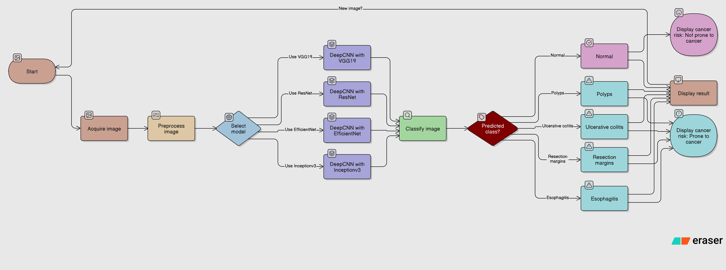

WORK FLOW

Slide 10
PROPOSED METHOD
Train deep learning models (VGG19,ResNet,EfficientNet,InceptionV3) for classification of gastric conditions.
Classifies input endoscopic images into one of 5 gastrointestinal conditions, improving diagnostic assistance and early detection accuracy.
Predict categories
1.Polyps
2.Ulcerative colitis
3.Resection Margins
4.Esophagitis
5.Normal
and evaluate model performance using accuracy, precision.

Slide 11
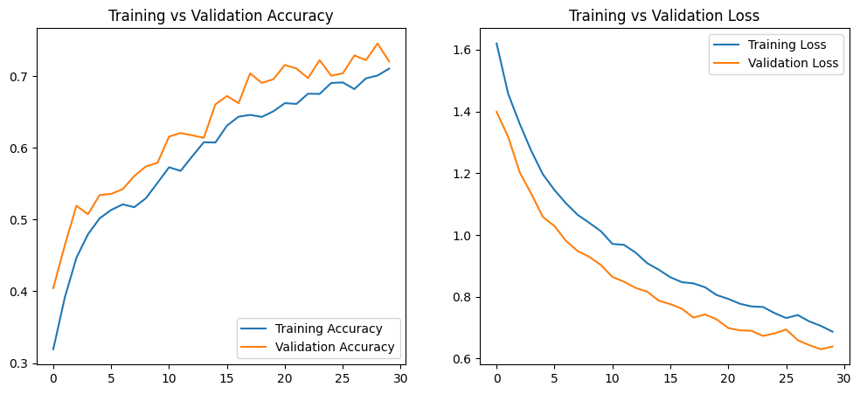
OUTPUT-VGG19

Slide 12
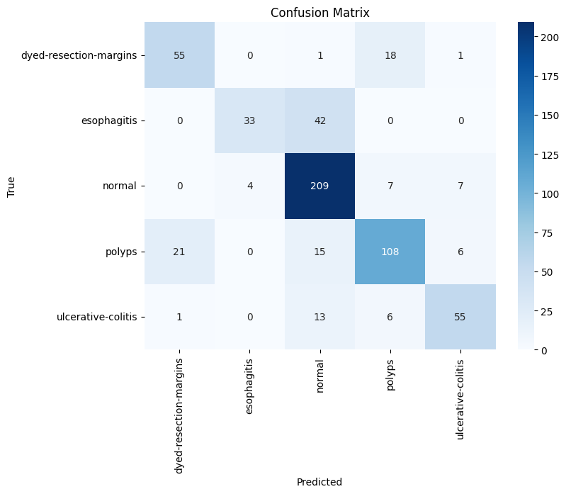
VGG19 – CONFUSION MATRIX

Slide 13
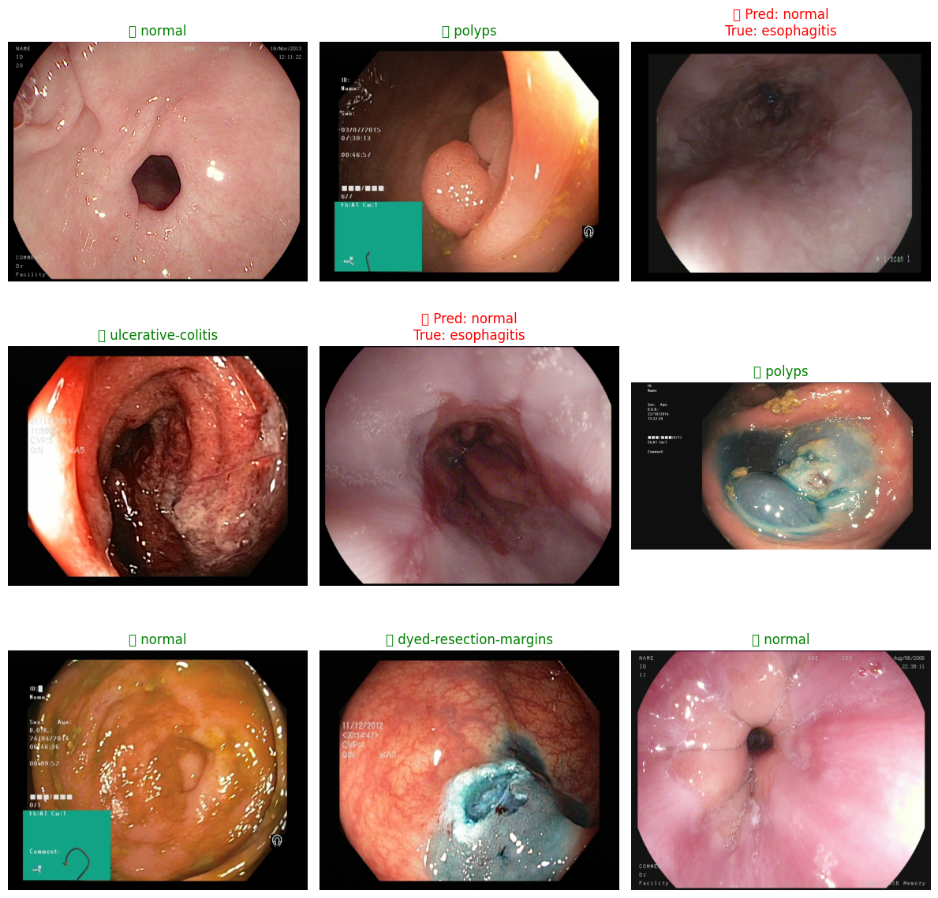
OUTPUT-VGG19

Slide 14
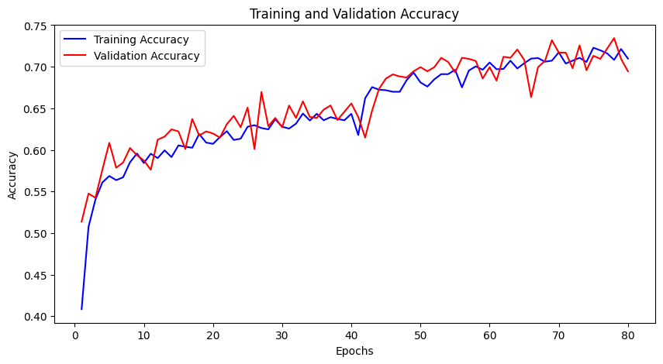
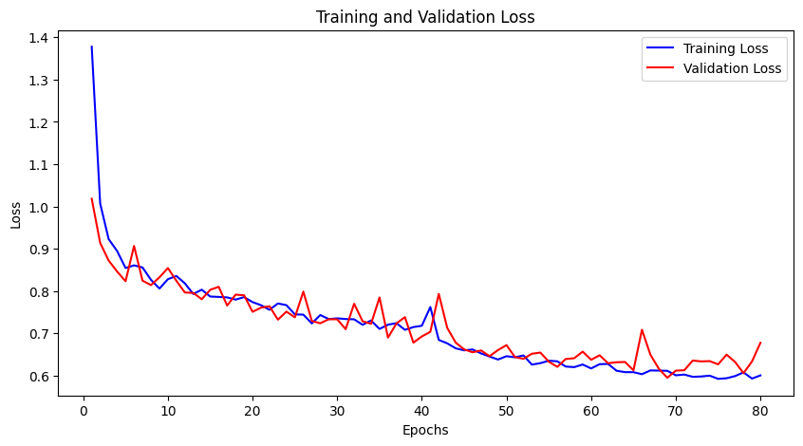
OUTPUT - ResNet50

Slide 15
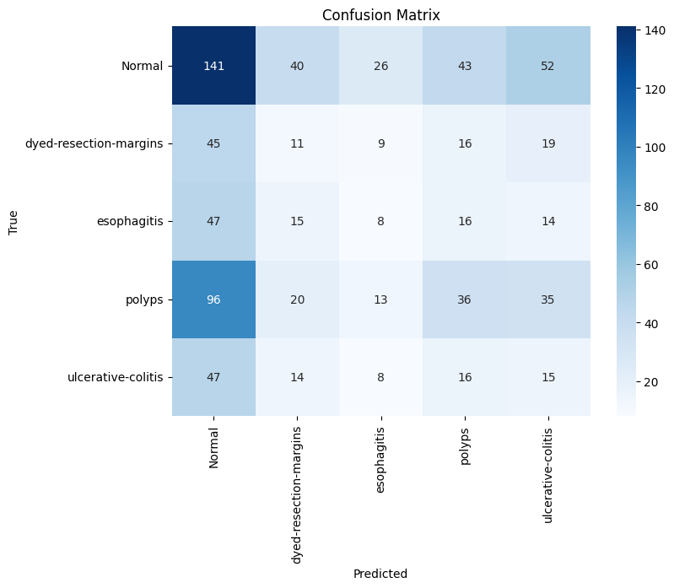
ResNet50 – CONFUSION MATRIX

Slide 16
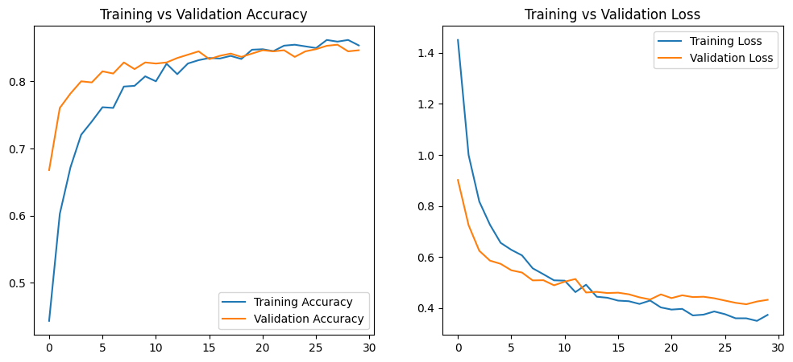
OUTPUT – InceptionV3

Slide 17
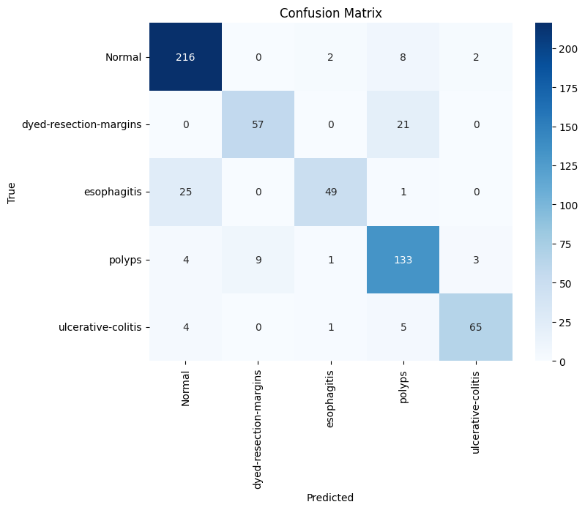
InceptionV3 – CONFUSION MATRIX

Slide 18
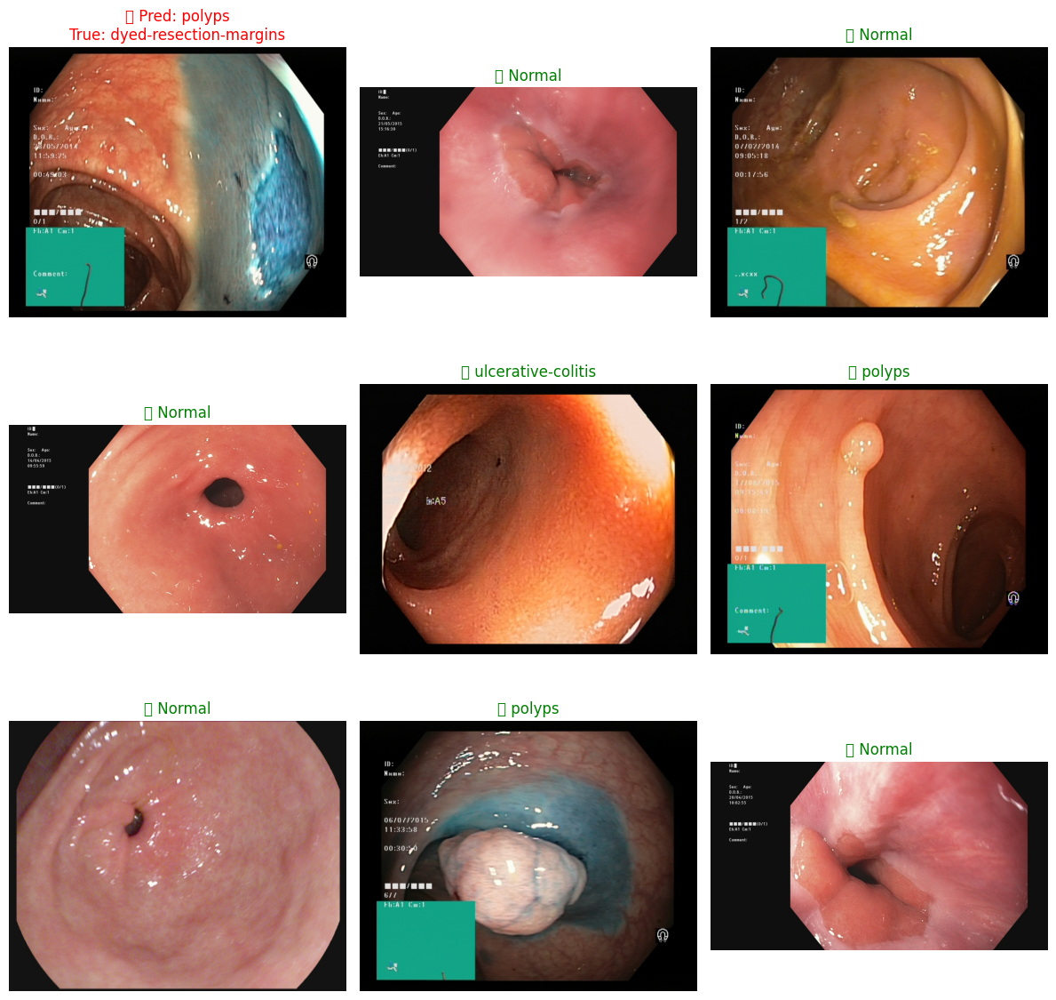
OUTPUT – InceptionV3

Slide 19
CONCLUSION
The proposed system, leveraging Deep Convolutional Neural Networks, successfully classifies endoscopic images into multiple clinically relevant categories, aiding in the early detection of gastric conditions, including potential indicators of gastric cancer.
By overcoming the limitations of traditional approach, this method offers enhanced diagnostic precision, faster screening, and serves as a valuable clinical decision-support tool for early gastric cancer diagnosis.
The system is designed to support clinicians by improving diagnostic accuracy and reducing missed early-stage cases. Future work can include real-time implementation and expansion to larger annotated datasets.

Slide 20
REFERENCES
1. Oliva, S., et al. (2020). Deep learning for automatic detection of early gastric cancer in endoscopic images: A multi-center study. Gastroenterology. https://doi.org/10.1053/j.gastro.2020.01.004
2. Shin, H. C., et al. (2016). Deep convolutional neural networks for computer-aided detection: CNN architectures, dataset characteristics and transfer learning. IEEE Transactions on Medical Imaging, 35(5), 1285–1298. https://doi.org/10.1109/TMI.2016.2528162.
3. He, K., Zhang, X., Ren, S., & Sun, J. (2016). Deep residual learning for image recognition. In Proceedings of the IEEE Conference on Computer Vision and Pattern Recognition (CVPR). https://arxiv.org/abs/1512.03385.
4. Pogorelov, K., et al. (2017). Kvasir: A multi-class image dataset for computer aided gastrointestinal disease detection. In Proceedings of the ACM Multimedia Systems Conference. https://doi.org/10.1145/3083187.3083212.
5. Zhou, Y., et al. (2018). Automatic polyp detection in colonoscopy videos using 3D CNN and fully connected CRF. IEEE Transactions on Medical Imaging, 37(6), 1331–1341. https://doi.org/10.1109/TMI.2017.2786457.

Slide 21


